Slide 1


Slide 2

CS619 - Software Projects
Student Performance
Predictor & Dashboard
Phase 4 - Recommendations Engine & Final Deliverable
Virtual University of Pakistan
Department of Computer Sciences | Fall 2025
Presented By: Syeda Farkhanda Batool Naqvi & Saad Shakir | BC220424824, BC220404989
ML
Flask
Plotly
Pandas
Scikit-learn
2000 Students . Logistic Regression . 4 Phases

Slide 3
Group Members Introduction
We are final-year students driven by a shared vision to bridge the gap between academic data and actionable
intelligence.
Our Objective:
Our Final Year Project integrates predictive modeling with intelligent visualization to transform raw educational data into meaningful insights.
The system uncovers hidden performance patterns, supports data-driven academic decisions, and contributes to improving outcomes at scale.
We believe education should rely on evidence, analytics, and foresight - not assumptions.
Syeda Farkhanda Batool Naqvi
[BC220424824]
BS Computer Science
(BSCS)
Saad Shakir
[BC220404989]
BS Information Technology
(BSIT)
SF
SS

Slide 4
Abstract
Student Performance Predictor & Dashboard - A machine learning-driven decision support system designed to predict student outcomes and enable early academic intervention.
🧠 Model Outcome
🚨 Core Innovation
🎯 Impact
Logistic Regression model selected
Accuracy: 96.50 %
F1 Score: 0.9647
Predicts Pass / Fail outcomes
Intelligent Recommendation Engine
Risk detection using predict_proba()
4-level risk classification
10 academic dimensions
Identifies at-risk students early
Provides personalized improvement plans
Supports data-driven academic decisions
Early alert notifications
From prediction to intervention - transforming academic data into actionable intelligence.

Slide 5
Project Overview
End-to-end ML pipeline from raw data to intelligent dashboard
ALL 4 PHASES AT A GLANCE
Phase 1 | Phase 2 | Phase 3 | Phase 4
2000 student records 34 attributes/student 5 courses covered Source: Kaggle + synthetic Target: Pass / Fail | Missing value handling LabelEncoder (5 cols) 4 models trained & compared StandardScalar (26 cols) Artifacts saved as .pkl 4 Models trained & compared Logistic Regression selected | Flask web application Role-based login system Teacher view: cohort analytics Student view: personal scores Interactive Plotly charts | 10-dimension rule analysis predict_proba() risk scoring 4-tier risk classification Early alert banners Personalized action plans
Domain: Educational Data Mining (EDM) . Tools: Python, Flask, Scikit-learn, Plotly, Pandas, Joblib, MySQl 8.0
CS619 · Phase 4 · Student Performance Predictor

Slide 6
Phase 1 - Dataset Preparation
2000 student records . 34 attributes . 5 courses
2,000
34
5
14.6%
Student Records
Attributes/Student
Courses Covered
At-Risk Students
KEY ATTRIBUTES
DATASET COMPOSITION
Student_ID / Registration_No Attendance_Percentage Average_Assignment Average_Quiz Midterm_Exam Final_Exam CGPA / Previous_GPA Study_Hours_Per_Week Performance Final_Result | Unique student identifier Classes attended / Total classes Mean of 3 assignment scores Mean of 2 quiz scores Midterm examination result Final examination result Cumulative grade point average Self-reported weekly study hours Excellent/VeryGood/Good/Avg/At-Risk Binary target: Pass / Fail
Excellent Very Good Good Average At-Risk | 524 students 656 students 389 students 139 students 292 students

Slide 7
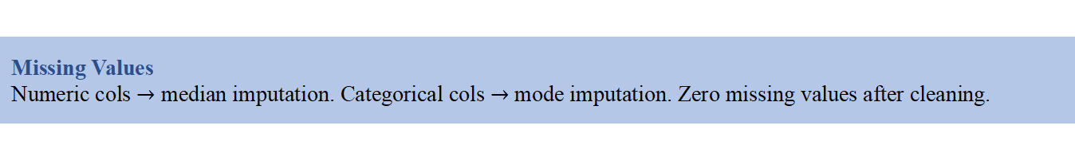
Phase 2 - Preprocessing & Machine Learning
Missing Value Handling . LabelEncoder (5cols) . StandardScaler (26 cols) . 80/20 Split
1.
Missing Values
Numeric cols $→$ median imputation. Categorical cols $→$ mode imputation. Zero missing values after cleaning.
2.
Label Encoding
5 categorical features encoded: Gender, Course, Section, Sports_Activity, Club_Membership. Saved as student_feature_encoders_v1.pkl.
3.
StandardScaler
26 numeric features standardized (zero mean, unit variance). Saved as student_scaler_v1.pkl. Only transform() on test/new data - never fit_transform().
4.
Train/Test Split
80% training (1,600 rows) / 20% testing (400 rows). Stratified by Performance class. random_state=42 for reproducibility.

Slide 8
Phase 2 - Model Comparison
4 algorithms evaluated on 31-feature dataset with 5-fold stratified cross-validation
MODEL COMPARISON RESULTS
Model | Accuracy | Precision | Recall | F1-Score | Status
Logistic Regression | 0.9650 | 0.9656 | 0.9650 | 0.9647 | Best
Random Forest | 0.9225 | 0.9226 | 0.9225 | 0.9221 | Good
Decision Tree | 0.8925 | 0.8945 | 0.8925 | 0.8931 | Good
Support Vector Machine | 0.9175 | 0.9214 | 0.9175 | 0.9116 | Good

Slide 9
Phase 2 - Model Comparison
4 algorithms evaluated on 31-feature dataset with 5-fold stratified cross-validation
Why logistic Mode?
Best Accuracy
96.50% test accuracy - highest among all 4 models on this dataset.
Probability Output
predict_proba() gives fail probability per student - powers the 4-tier risk system in Phase 4.
Fast Inference
Fastest runtime - all 2,000 students scored at server startup with no delay.

Slide 10
Phase 2 - ML Artifacts (.pkl Files)
Four artifacts saved using Joblib - loaded by Phase 3 & Phase 4 app.py at server startup
student_model_v1.pkl
Trained Logistic Regression model
Used by predict_all_students() to generate pass/fail predictions and probability scores for all 2,000 students.
student_scaler_v1.pkl
Fitted StandardScaler (26 numeric features)
Applied via scaler.transform() on new data. Never re-fitted - ensures same normalization as Phase 2 training.
student_encoder_v1.pkl
LabelEncoder for Performance (target label)
Decodes model's integer predictions back to human-readable labels: Excellent, Very Good, Good, Average, At-Risk.
student_feature_encoders_v1.pkl
Dict of 5 LabelEncoders for categorical features
Encodes Gender, Course, Section, Sports_Activity, Club_Membership. Unknown values mapped to first known class to prevent errors.

Slide 11
Phase 3 - Interactive Dashboard
Flask web app . Role-based login . Teacher & Student views
👩‍ 🏫 Teacher Dashboard
🎓 Student Dashboard
✓ 6 KPI stat cards: Total, Pass, Fail, Avg Final Exam, Avg Attendance, Avg CGPA
✓ Student banner: predicted outcome badge, risk color coding
✓ 3 interactive Plotly charts: Pass/Fail donut, Performance bar, Score breakdown
✓ 6 mini stat cards: Prev GPA, Attendance, Study Hrs, Library, Online Hrs, Total Score
✓ Score progress bars with +/- delta vs class averages
✓ Tabbed student table: At-Risk (sorted by fail %) and All Students tabs
✓ Grouped bar chart: Student vs Class
✓ Live search/filter across all records
✓ Grouped bar chart: student vs class average across 6 categories
✓ CSV export: At-Risk only or full dataset with predictions
✓ Strengths section: badges for above-average dimensions
✓ Alert banner showing at-risk count with intervention message
✓ Personalized recommendation cards from Phase 4 engine

Slide 12
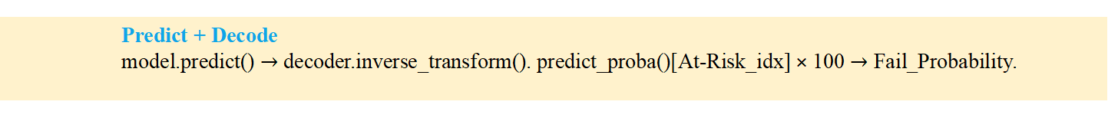

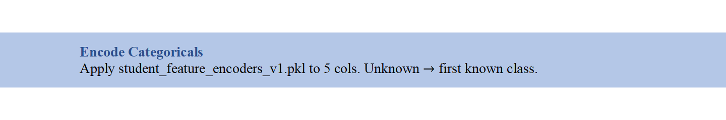
ML Prediction Pipeline - 5 Steps
predict_all_students() in app.py - bulletproof pipeline, immune to MySQL extra column issues
Step
A
  Encode Categoricals
  Apply student_feature_encoders_v1.pkl to 5 cols. Unknown $→$ first known class.
Step
B
  Select Exactly 31 Features
  Explicitly pick the 31 MODEL_COLS in exact order. Ignores MySQL id column - root fix.
Step
C
  NaN/Inf Cleanup
  Coerce numeric $→$ fill NaN with medians $→$ fill 0 $→$ replace ±inf. Triple-layer safety.
Step
D
  StandardScaler Transform
  scaler.transform() on 26 numeric cols. Never re-fit. Post-scale cleanup applied.
Step
E
  Predict + Decode
  model.predict() $→$ decoder.inverse_transform(). predict_proba()[At-Risk_idx] × 100 $→$ Fail_Probability.
Data Leakage Prevention: MODEL_COLS never includes Final_Result or Performance. scaler.transform() only - never re-fit on new data.

Slide 13
Phase 4 - Recommendations Engine Using Python
10 Academic Dimensions . 4 Risk Tiers . Early Alerts . Strengths Recognition
1.
Study Hours
< 5 hrs/week = Very Low. < Class Avg - 5 = Warning.
> = 20 = Strength.
Attendance
< 60% = Critical alert (exam barred risk). < 75% = Warning.
> = 90% = Strength.
6.
CGPA
< 2.0 = Critical (probation alert). < Class Avg - 0.5 = Warning
> = 3.5 = Strength.
Assignment Score
< 40 = Critical. < Class Avg - 10 = Warning.
> = 80 = Strength.
7.
2.
Lab Work
< 40 = Needs attention. < Class Avg - 10 = Warning.
>= 80 = Strength.
Quiz Score
< 40 = Serious. < Class Avg - 10 = Warning.
> = 80 = Strength.
8.
3.
Project Score
< 40 = Below standard. < Class Avg - 10 = Warning.
> = 80 = Strength.
Midterm Exam
< 40 = Critical alert. < Class Avg - 10 = Warning.
> = 80 = Strength.
9.
4.
Extra Classes
Triggered when Fail Probability >= 30%.
Links to tutorial session enrollment.
Final Exam
< 40 = Critical alert. < Class Avg - 10 = Warning.
> = 80 = Strength.
10.
5.

Slide 14
Risk Level Classification System
4-tier risk classification from predict_proba() At-Risk class probability
4-TIER RISK CLASSIFICATION
🔴 CRITICAL
🟠 HIGH RISK
🔵 MEDIUM
🟢 LOW RISK
Fail Prob ≥ 70%
Fail Prob 50 – 69%
Fail Prob 30 – 49%
Fail Prob < 30%
Immediate intervention. Multiple early alert banners displayed. Extra classes enrollment suggested.
Urgent academic support. Targeted recommendations for weakest dimensions.
Monitoring recommended. Improvement guidance and extra sessions suggested.
Continue current performance. Strengths highlighted. Mentorship opportunities suggested.
All 2,000 students receive a Fail_Probability score from predict_proba().
Students with Performance='At-Risk' are classified into one of these tiers; all others display Low/Green.
·
·

Slide 15
System Architecture
From raw CSV data to browser dashboard in 7 steps
END-TO-END DATA FLOW
Load Artifacts
student_model_v1.pkl, student_scaler_v1.pkl, student_encoder_v1.pkl, student_feature_encoders_v1.pkl
Import Data
First run: 2,000 rows imported from processed_student_data.csv. Subsequent runs: loaded from MySQL
Predict All
Adds Performance, Final_Result, Fail_Probability columns to all 2,000 records
Save Predictions
Upserts Predicted_Result, Fail_Probability, Risk_Level to predictions table
Login
Teacher: password only. Student: Student_ID + password
Teacher View
Analytics charts + at-risk table + CSV export
Student View
Scores + comparison + recommendations engine output

Slide 16
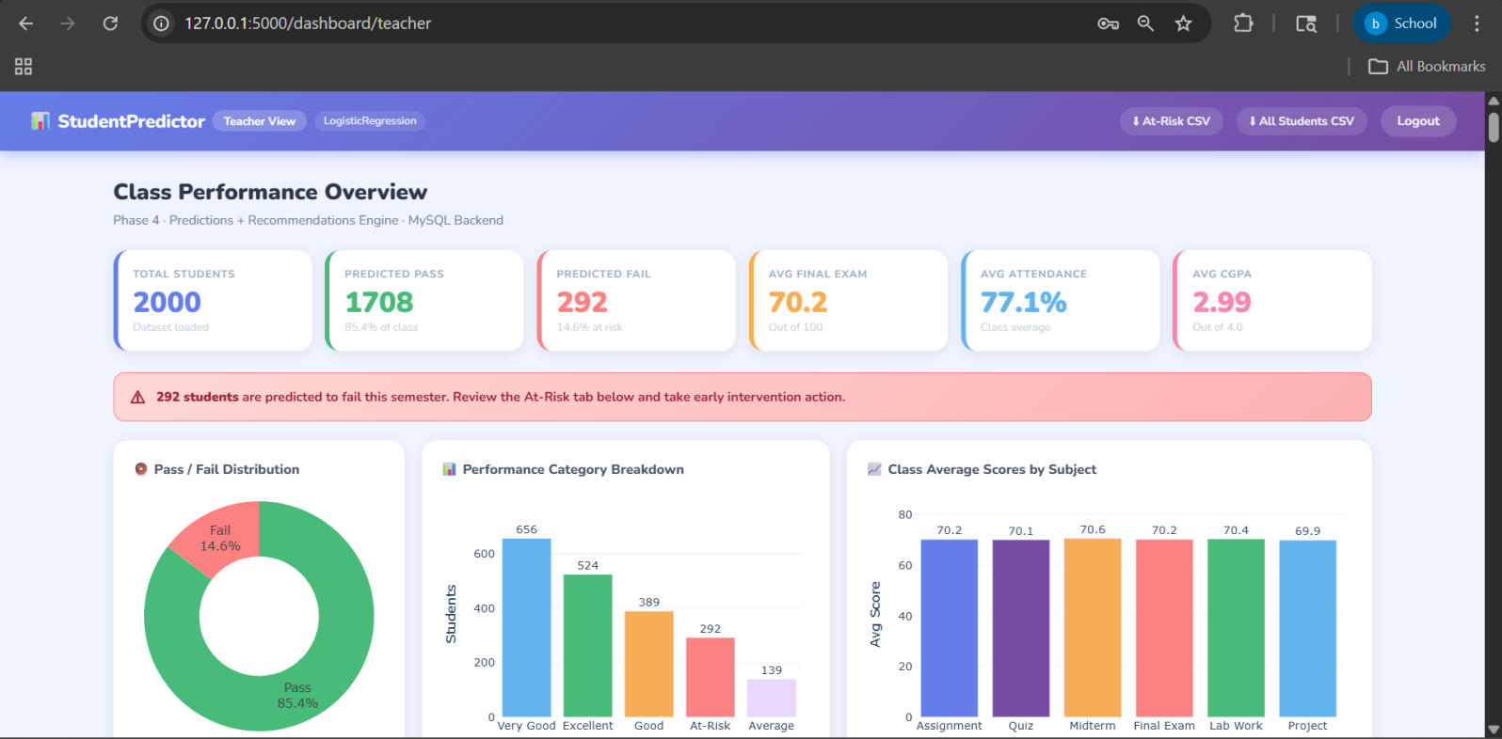
Dashboard Screenshots - System in Action
Teacher Dashboard . Student Dashboard . Recommendations View
TEACHER DASHBOARD - KPI CARDS AND CHARTS

Slide 17
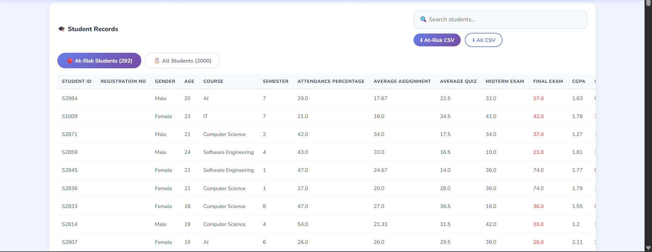
Dashboard Screenshots - System in Action
Teacher Dashboard . Student Dashboard . Recommendations View
TEACHER DASHBOARD - AT-RISK STUDENTS TABLE

Slide 18
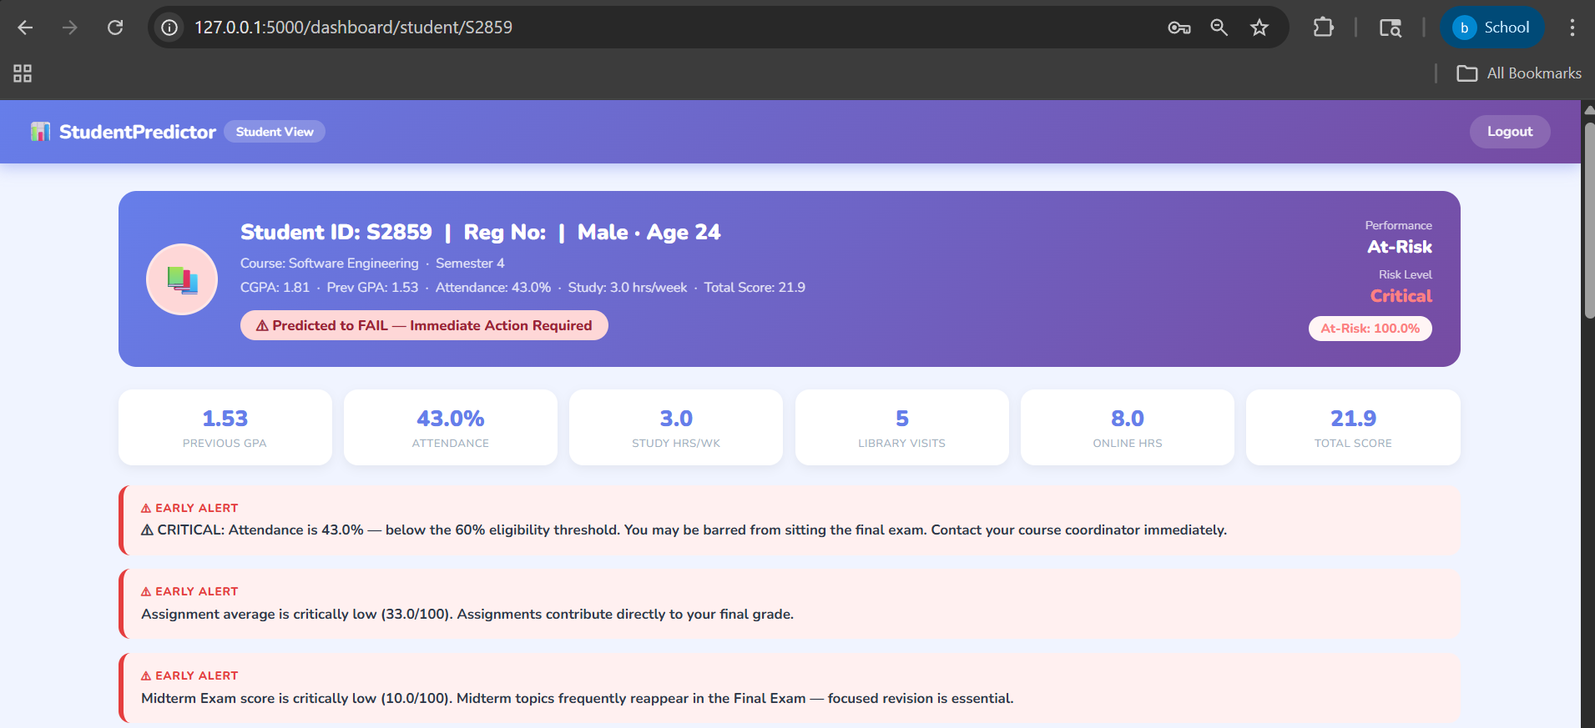
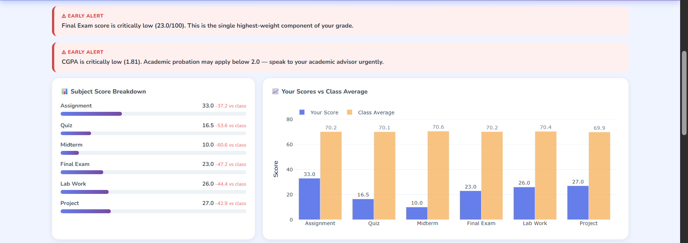
Dashboard Screenshots - System in Action
Teacher Dashboard . Student Dashboard . Recommendations View
STUDENT DASHBOARD - BANNER, MINI-CARDS, AND SCORE COMPARISON

Slide 19
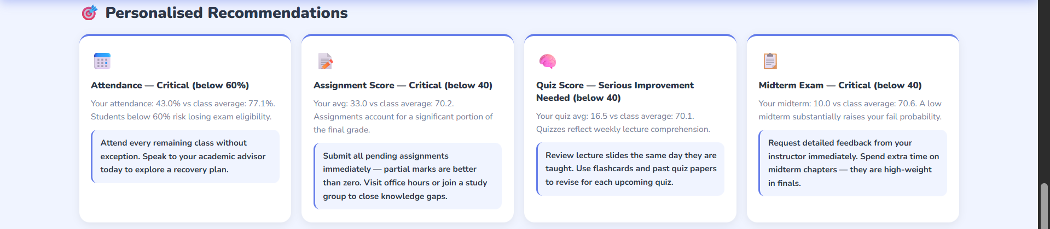
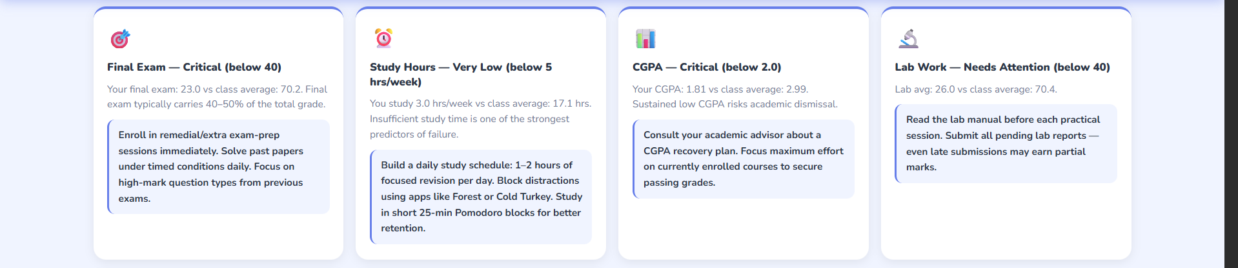
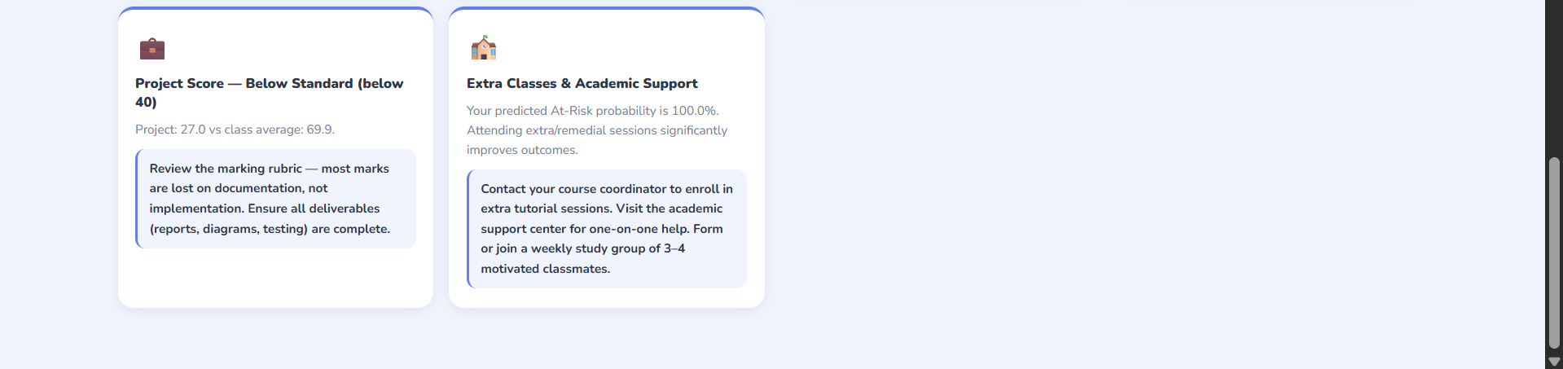
Dashboard Screenshots - System in Action
Teacher Dashboard . Student Dashboard . Recommendations View
STUDENT DASHBOARD - RECOMMENDATIONS ENGINE OUTPUT

Slide 20
Results & Evaluation
Model performance . Dataset summary . System achievements
2,000
85.4%
96.5%
Total Students
Pass Rate
Model Accuracy
0.9647
10
4
F1-Score
Rec. Dimensions
Risk Levels
Model: Logistic Regression
Key Achievements
Train Accuracy
96.5%
Test Accuracy
96.5%
Weighted Precision
0.9656
✓ Role-based login (Teacher / Student)
✓ Zero data leakage in ML pipeline
✓ 10-dimension recommendations engine
✓ Bulletproof 5-step ML pipeline
✓ Interactive Plotly charts (3 teacher + 1 student)
✓ Early alert banners for 5 critical thresholds
✓ 4-tier risk classification system
✓ CSV export for at-risk and all students
Weighted Recall
0.9650
Weighted F1-Score
0.9647
Features Used
31 features(26 numeric+ 5 Categorical)
Saved As
student_model_v1.pkl, student_scaler_v1.pkl

Slide 21
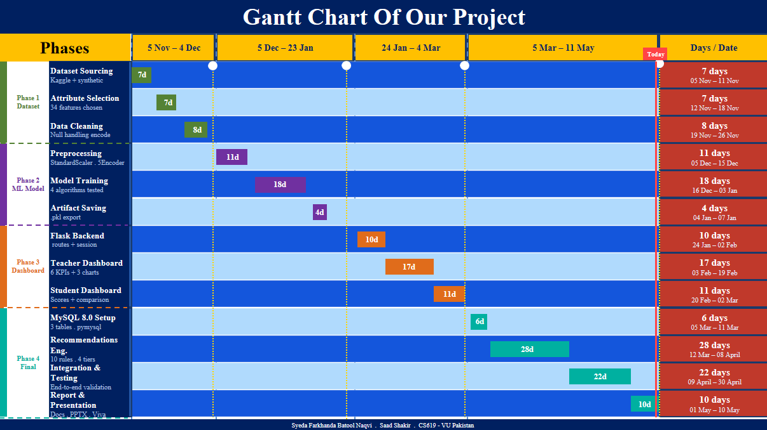

Slide 22
Tools And Technologies Used
Python
Flask
Pandas
NumPy
Scikit-learn
Core language
Web framework
Data processing
Numerical ops
ML pipeline
Joblib (.pkl)
Plotly
PyMySQL
MySQL 8.0
Jinja2
Artifact storage
Interactive charts
DB connector
Database
Template engine
StandardScaler
LabelEncoder
HTML / CSS / JS
Windows OS
Matplotlib
Feature scaling
Categorical encoding
Frontend UI
Development OS
Phase 2 plots

Slide 23
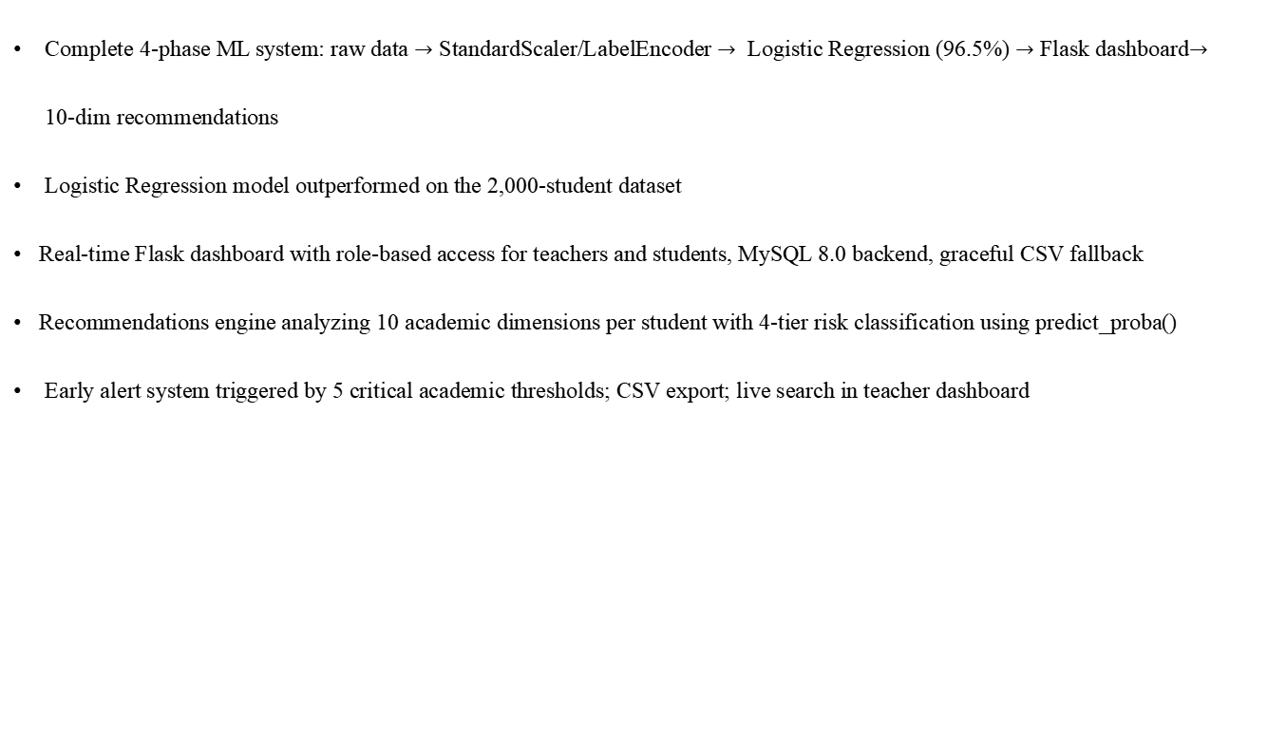
Conclusion
WHAT WE BUILT
Complete 4-phase ML system: raw data $→$ StandardScaler/LabelEncoder $→$ Logistic Regression (96.5%) $→$ Flask dashboard$→$
10-dim recommendations
Logistic Regression model outperformed on the 2,000-student dataset
Real-time Flask dashboard with role-based access for teachers and students, MySQL 8.0 backend, graceful CSV fallback
Recommendations engine analyzing 10 academic dimensions per student with 4-tier risk classification using predict_proba()
Early alert system triggered by 5 critical academic thresholds; CSV export; live search in teacher dashboard

Slide 24
Future Work
FUTURE ENHANCEMENTS
🏗
📧
📈
☁
🧠
Real-Time Integration
Email Alerts
Time-Series
Cloud Deploy
Deep Learning
Connect directly to University SIS APIs for live data updates
Auto-notify teachers
on critical risk
Track trends over
multiple semesters
Heroku / AWS
institutional access
LSTM for sequential
performance prediction
📱
🔒
Mobile App
Production Security
Student self-reporting
via mobile UI
Bcrypt, CSRF, HTTPS, & Rate Limiting for institutional scale.

Slide 25
Thank You
CS619 Final Project . Virtual University of Pakistan . Fall 2025
Syeda Farkhanda Batool Naqvi . Saad Shakir
BC220424824 . BC220404989

